Slide 1

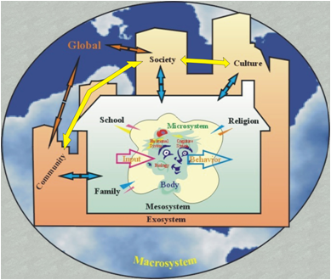
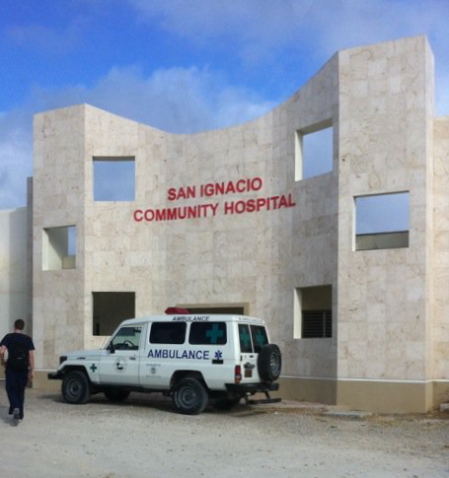
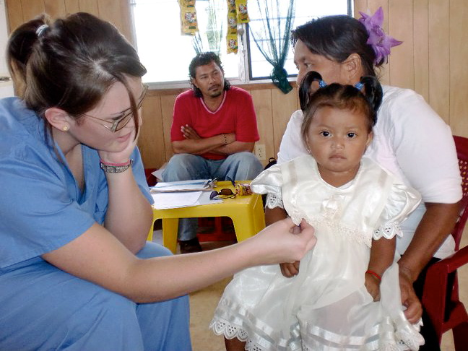

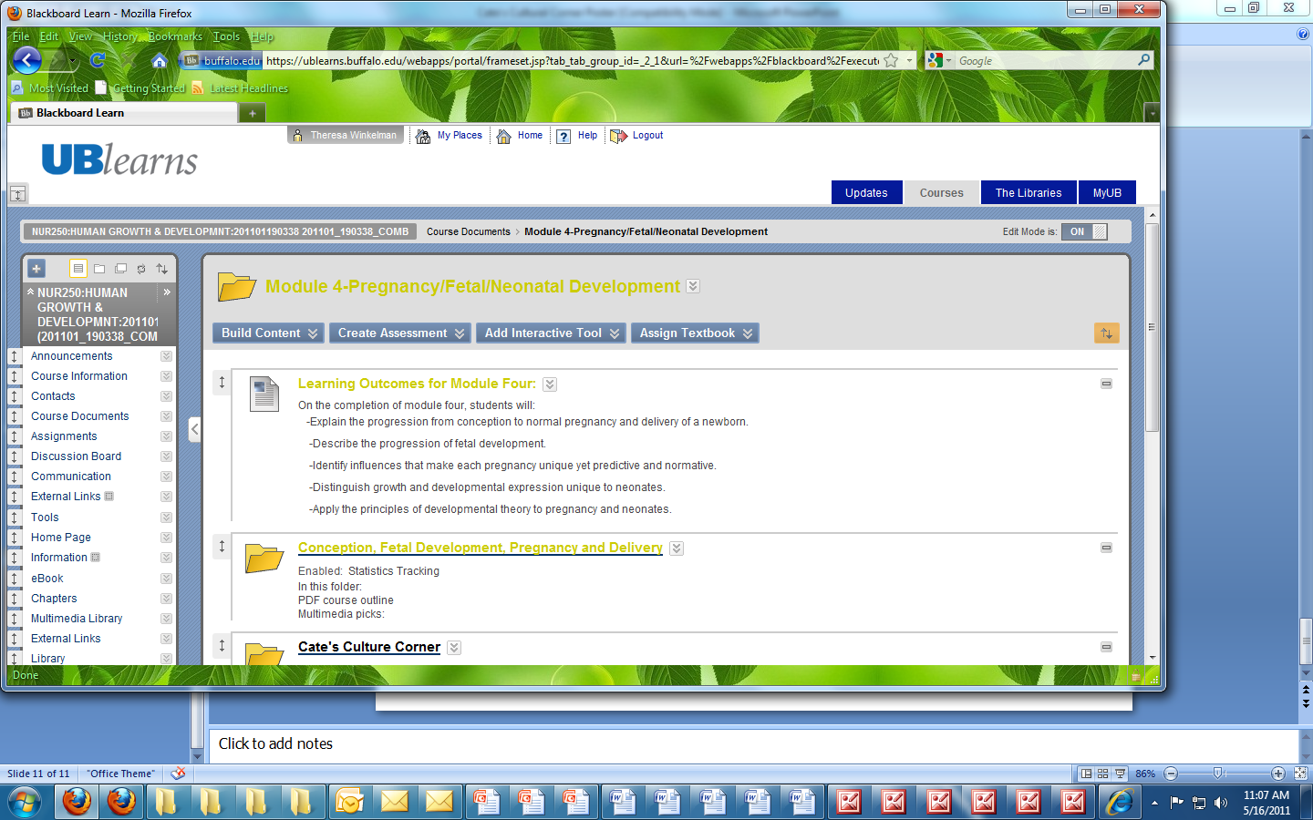

Cate’s Cultural Corner: Translating Student Scholarship into Classroom Engagement
Theresa A. Winkelman, Clinical Assistant Professor, RN,MS, CPNP,
Caitlin McKinnon, Undergraduate student-nursing major
School of Nursing, University at Buffalo, the State University of New York
Introduction
The content of Human Growth and Development (NUR 250) is foundationally based on the richness of an individual’s cultural stimuli and the developmental expression.
The teaching challenge is to translate this information beyond the textbook and classroom to make it meaningful to a large class (180 students) of undergraduate students.
The average student in today’s world is more technologically savvy than we have ever seen before.
Providing learning activities
that make culture “come alive”
in a medium that the students
can actively participate was the
goal of this teaching-learning
initiative.
Weekly On-line Learning Activity
Cate created a brief online presentation imbedded in weekly modules in the Blackboard learning system. The presentation included:
  Pictures and text about the people of Belize
  Comparisons of customs and culture of Belize to that of the US in regard to child rearing, discipline, role of family, healthcare, education, opportunities for emerging adults
  Upon completion, a critical thinking question was posed and students from this large classroom (180 students) were invited to blog on cultural issues that affect the developmental expression of individuals
  Students were encouraged to share their own cultural experiences and relate this information to the core concepts of developmental theory. We monitored and gave feedback to the students who participated
  Participation was voluntary and not graded
Sample Blog Questions
Results: Overall perspective
Classroom Perspective:
  Increased reference to cultural influences in classroom discussions and critical thinking question responses.
Independent Study
“This opportunity has been the best decision thus far in furthering my education at UB. Doing an independent study allows you the one-on-one time to ask multiple questions and receive direct feedback from a professor.” –Cate McKinnon
Student Feedback:
“…Cate’s Cultural Corner inspired me to go on a mission myself” -unidentified classroom student
  The average weekly posting: 20 responses
  Voluntary responses-non-grade generating
  The diversity of the class’s responses:
  Korean
Japanese
Indian
American
Philippine
Conclusions
The assignment was a win-win for everyone
Our final evaluation of the initiative and our recommendations for improvement include:
Keep the assignment non-graded because it resulted in motivated students who posted meaningful responses.
Add You-tube videos to stimulate more student interest in the assignment.
Use opportunities to post :”Cate’s Cultural Corner” assignments in classroom discussion, think-pair-share activity and graded critical thinking questions.
Add more TA to help monitor posts and offer responses
Replicate the activity with IRB approval to generate specific student evaluation data.
Methodology
Sample Slide: “Stressors”
The learning activity was based on human development from conception to senescence in the context of:
  Selected structural and functional theories and principles
  Selected internal and external stimuli on the behavior
  Psychosocial theory of Urie Bromfenbrenner
Health: when a person becomes ill in Belize,
it is very expensive and difficult to obtain
the necessary treatments
Such illnesses place a great deal of stress on the family, both financially and emotionally.
Access to care is done via the community hospital, or nearby traveling clinics.
Health Clinic in San Marcus, Belize: Taking the temperature of a young girl
Enter Cate…
Cate traveled to Belize on a medical mission with International Service Learning.
The student volunteers took on the roles of nurse assistants and quickly learned that health care varies based on economic standing, living arrangements, and overall accessibility.
It was upon Cate’s return to the U.S. that the idea of sharing this experience through an independent study would be greatly beneficial to the professor, classroom students and herself.
Human Growth and
Development was the
perfect venue to share
Cate’s experiences
and broaden the
students’ cultural
awareness beyond
the borders of the US.
Pregnancy:
  What is your take on the differences in pregnancy practice between theses two cultures?
  Do you have any cultural beliefs that support/argue the use of pain medication during pregnancy?
Family module:
  “Why do you think that family dynamics are changing in the newer, younger families. What might be a direct or indirect cause of such changes?”
  “How does culture play a role in your family?”
School ager:
  After previewing the picture slide show, I would like you to brainstorm some ideas on how you, as the teacher, would go about teaching the students about wellness (taking into consideration the limited supplies of the school as seen in some of the pictures). Also, which theorist that we've studied would approve of your teachings? Why?

